Slide 1
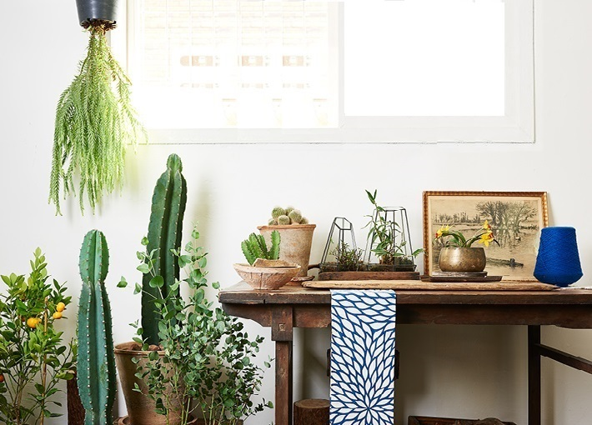

Project Folium
Presenters: Erik, Yun and John

Slide 2


Contents
Purpose
Three Features
Live demo
Final Retrospective

Slide 3

1. Purpose of the Folium
How can people “make their house more environmental-friendly”?
“Sharing idea about houseplants”

Slide 4

2. Three Features
Managing and registering My Plants
Search for Neighbor’s Plants
Getting and sharing an idea for decoration

Slide 5
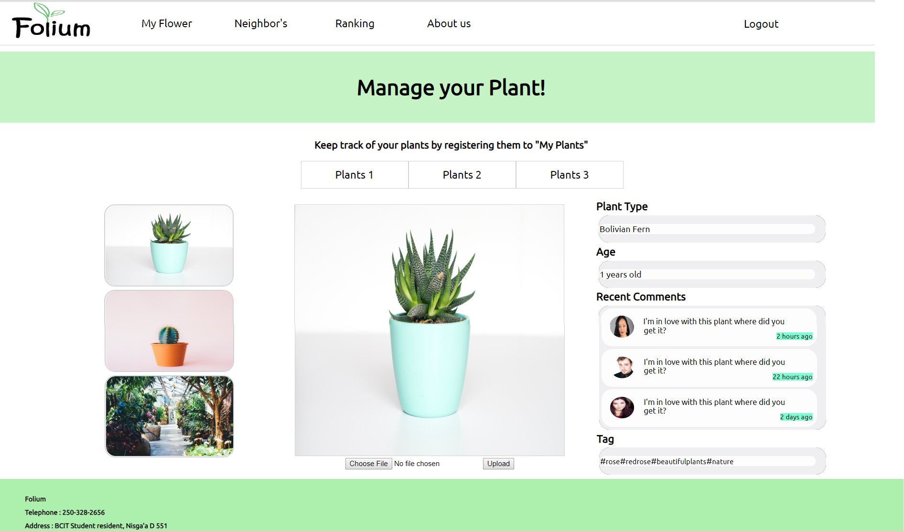

Slide 6
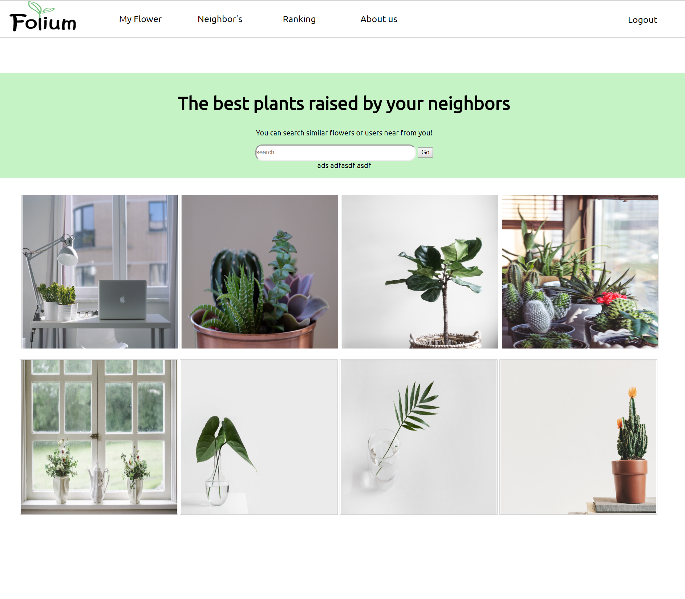

Slide 7
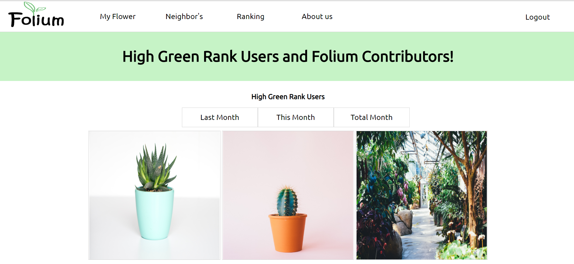
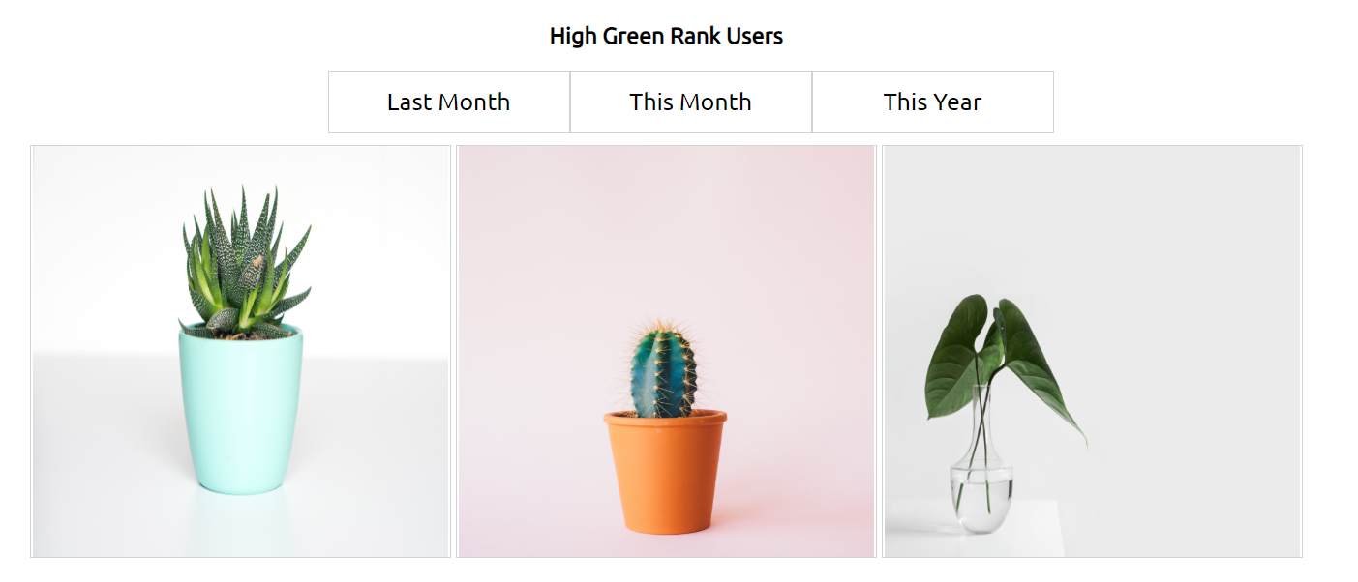
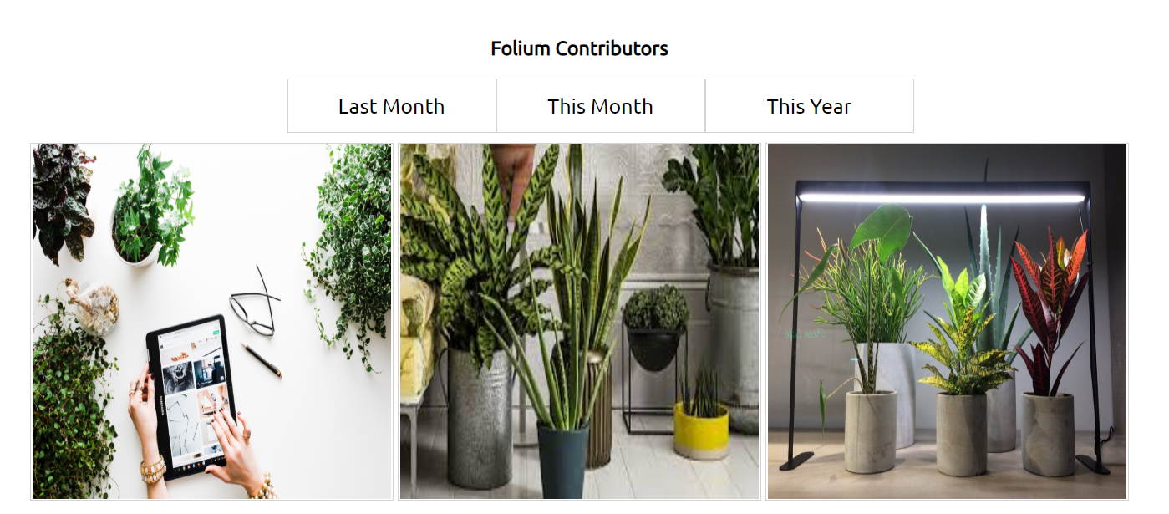

Slide 8
4. Final retrospective
What went well
Successfully created a front end web design
Collaboration and our ability to adapt and integrate with each other’s code
Successfully constructed a working back end
What did not go well
Difficulty with the back end due to the asynchronous nature of firebase
Minor troubles with complete integration of firebase with the frontend.
Challenging our perceptions of modern website design

Slide 9

Erik
Yun
John

